Slide 1
Recap lecture 30
Deciding whether two languages are equivalent or not, example, deciding whether an FA accept any string or not, method 3, examples, finiteness of a language

Slide 2
Context Free Grammar (CFG)
The earliest computers accepted no instructions other then their own assembly language. Every procedure, no matter how complicated , had to be encoded in the set of instructions, LOAD, STORE, ADD the contents of two registers and so on. The major problem was to display mathematical formulas as follows
(
8
−
0
)
2
+
(
7
−
10
)
2
+
(
11
−
10
)
2
S
=
2
or

Slide 3
CFG continued …
So, it was necessary to develop a way of writing such expressions in one line of standard typewriter symbols, so that in this way a high level language could be invented. Before the invention of computers, no one would ever have dreamed of writing such complicated formula in parentheses e.g. the right side of formula can be written as
((1/2)+9)/(4+(8/21)+(5/(3+(1/2))))

Slide 4
CFG continued …
The high level language is converted into assembly language codes by a program called compiler.
The compiler that takes the user’s programs as its inputs and prints out an equivalent program written in assembly language.
Like spoken languages, high level languages for computer have also, certain grammar. But in case of computers, the grammatical rules, don’t involve the meaning of the words.

Slide 5
CFG continued …
It can be noted that the grammatical rules which involve the meaning of words are called Semantics, while those don’t involve the meaning of the words are called Syntactics.
e.g. in English language, it can not be written “ Buildings sing ”, while in computer language one number is as good as another.
e.g. X = B + 10, X = B + 999
Following is a remark

Slide 6
Remark
In general, the rules of computer language grammar, are all syntactic and not semantic. A law of grammar is in reality a suggestion for possible substitutions.

Slide 7
CFG terminologies
Terminals: The symbols that can’t be replaced by anything are called terminals.
Non-Terminals: The symbols that must be replaced by other things are called non-terminals.
Productions: The grammatical rules are often called productions.

Slide 8
CFG
CFG is a collection of the followings
An alphabet Σ of letters called terminals from which the strings are formed, that will be the words of the language.
A set of symbols called non-terminals, one of which is S, stands for “start here”.
A finite set of productions of the form
non-terminal → finite string of terminals and /or non-terminals.
Following is a note in this regard

Slide 9
Note
The terminals are designated by small letters, while the non-terminals are designated by capital letters.
There is at least one production that has the non-terminal S as its left side.

Slide 10
Context Free Language (CFL)
The language generated by CFG is called Context Free Language (CFL).
Example:
Σ = {a}
productions:
S →aS
S→ Λ Applying production (1) six times and then production (2) once, the word aaaaaa is generated as

Slide 11
S aS
aaS
aaaS
aaaaS
aaaaaS
aaaaaaS
aaaaaaΛ
= aaaaaa

Slide 12
Example continued …
It can be observed that prod (2) generates Λ, a can be generated applying prod. (1) once and then prod. (2), aa can be generated applying prod. (1) twice and then prod. (2) and so on. This shows that the grammar defines the language expressed by a*.

Slide 13
Example
Σ = {a}
productions:
S→SS
S→a
S→ Λ
This grammar also defines the language expressed by a*.
Note: It is to be noted that Λ is considered to be non-terminal. It has a special status. If for a certain non-terminal N, there may be a production N→ Λ. This simply means that N can be deleted when it comes in the working string.

Slide 14
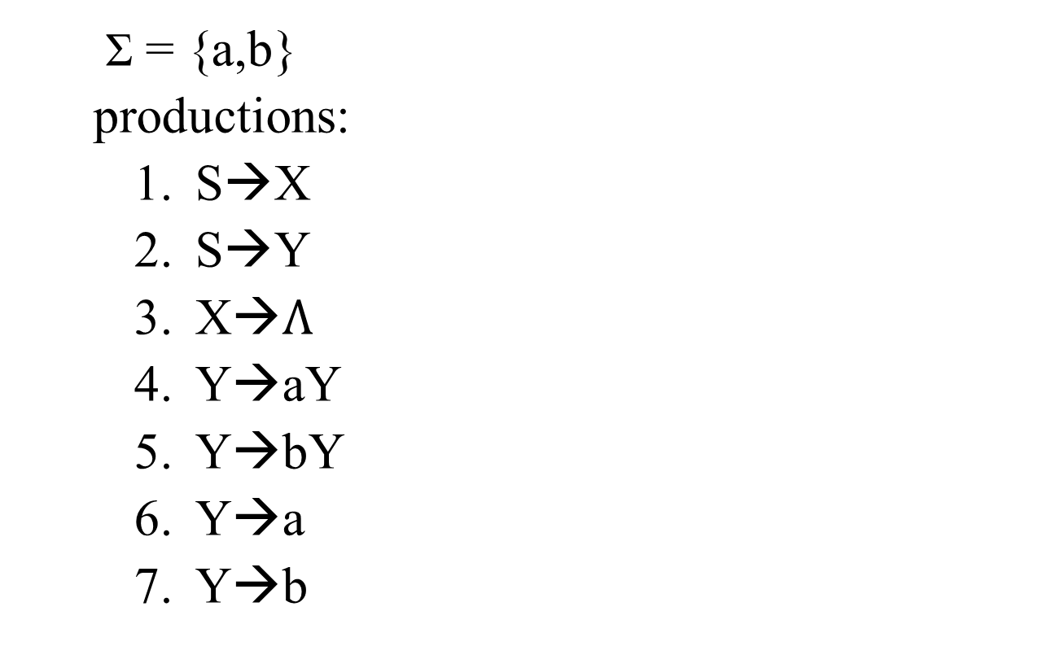
Example
Σ = {a,b}
productions:
S→X
S→Y
X→$Λ$
Y→aY
Y→bY
Y→a
Y→b

Slide 15
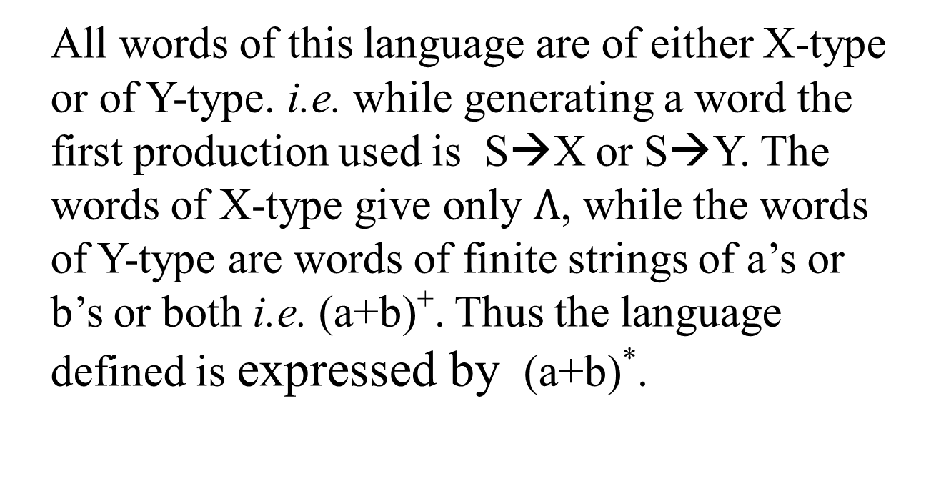
Example continued …
All words of this language are of either X-type or of Y-type. i.e. while generating a word the first production used is S→X or S→Y. The words of X-type give only $Λ$, while the words of Y-type are words of finite strings of a’s or b’s or both i.e. (a+b)⁺. Thus the language defined is expressed by (a+b)*.

Slide 16
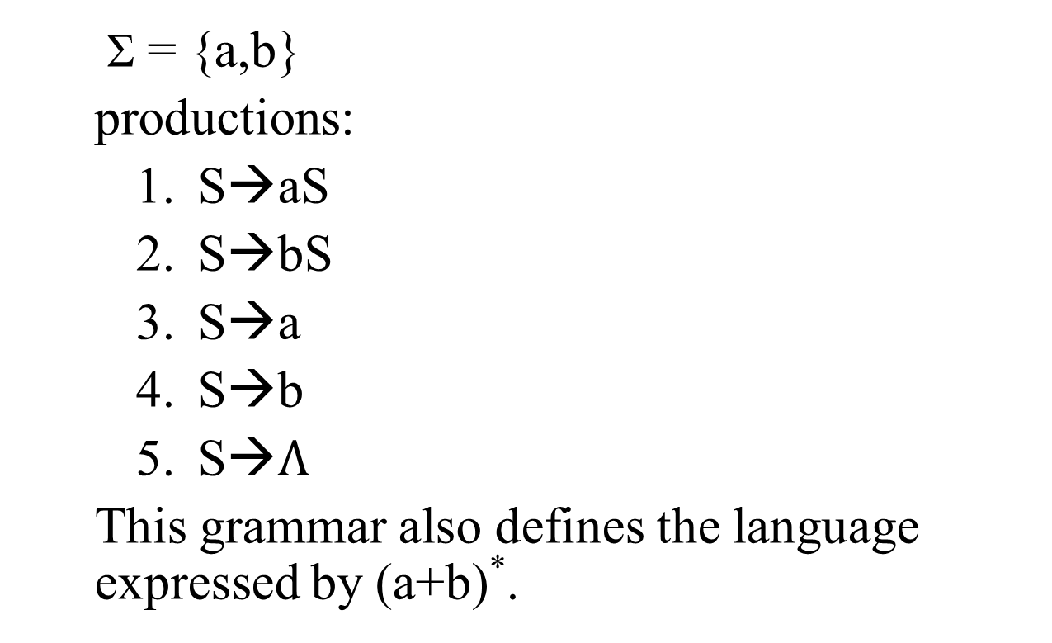
Example
Σ = {a,b}
productions:
S→aS
S→bS
S→a
S→b
S→$Λ$
This grammar also defines the language expressed by (a+b)*.

Slide 17
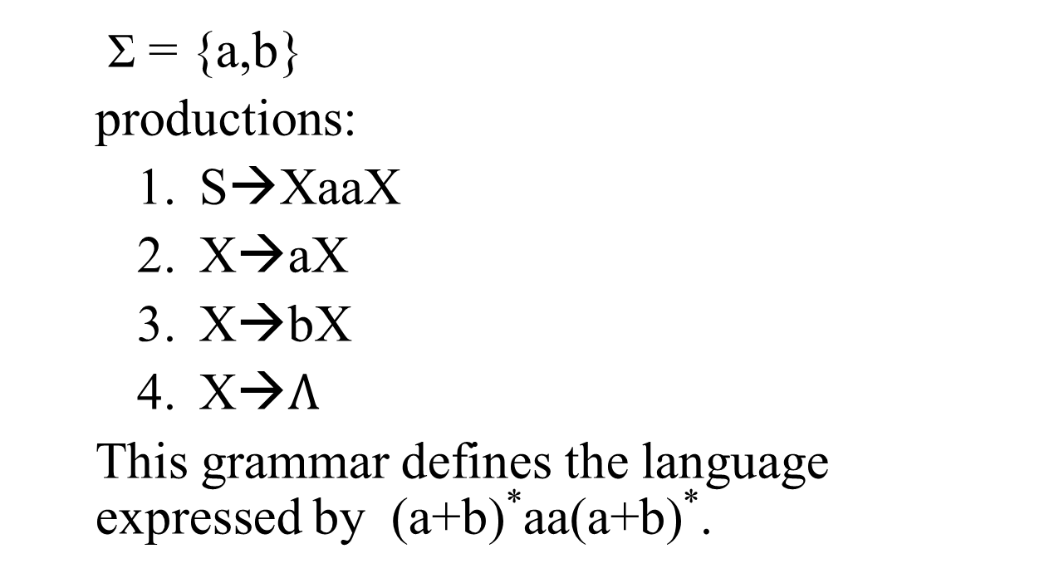
Example
Σ = {a,b}
productions:
S→XaaX
X→aX
X→bX
X→$Λ$
This grammar defines the language expressed by (a+b)*aa(a+b)*.

Slide 18
Summing Up
Context Free Grammar, Terminals, non-terminals, productions, CFG, context Free language, examples.

